Slide 1

Lung Cancer: Finding New Targets
Gregory Riely
@RielyMD
March 20, 2025

Slide 2
Disclosures
MSKCC receives research funding for my work from:
Mirati
Lilly
Takeda
Merck
Roche
Pfizer
Rain Therapeutics
Novartis

Slide 3
Agenda
Background on NSCLC
Approach to NSCLC in 2025
EGFR
EGFR part 2 (a failure)
KRAS

Slide 4
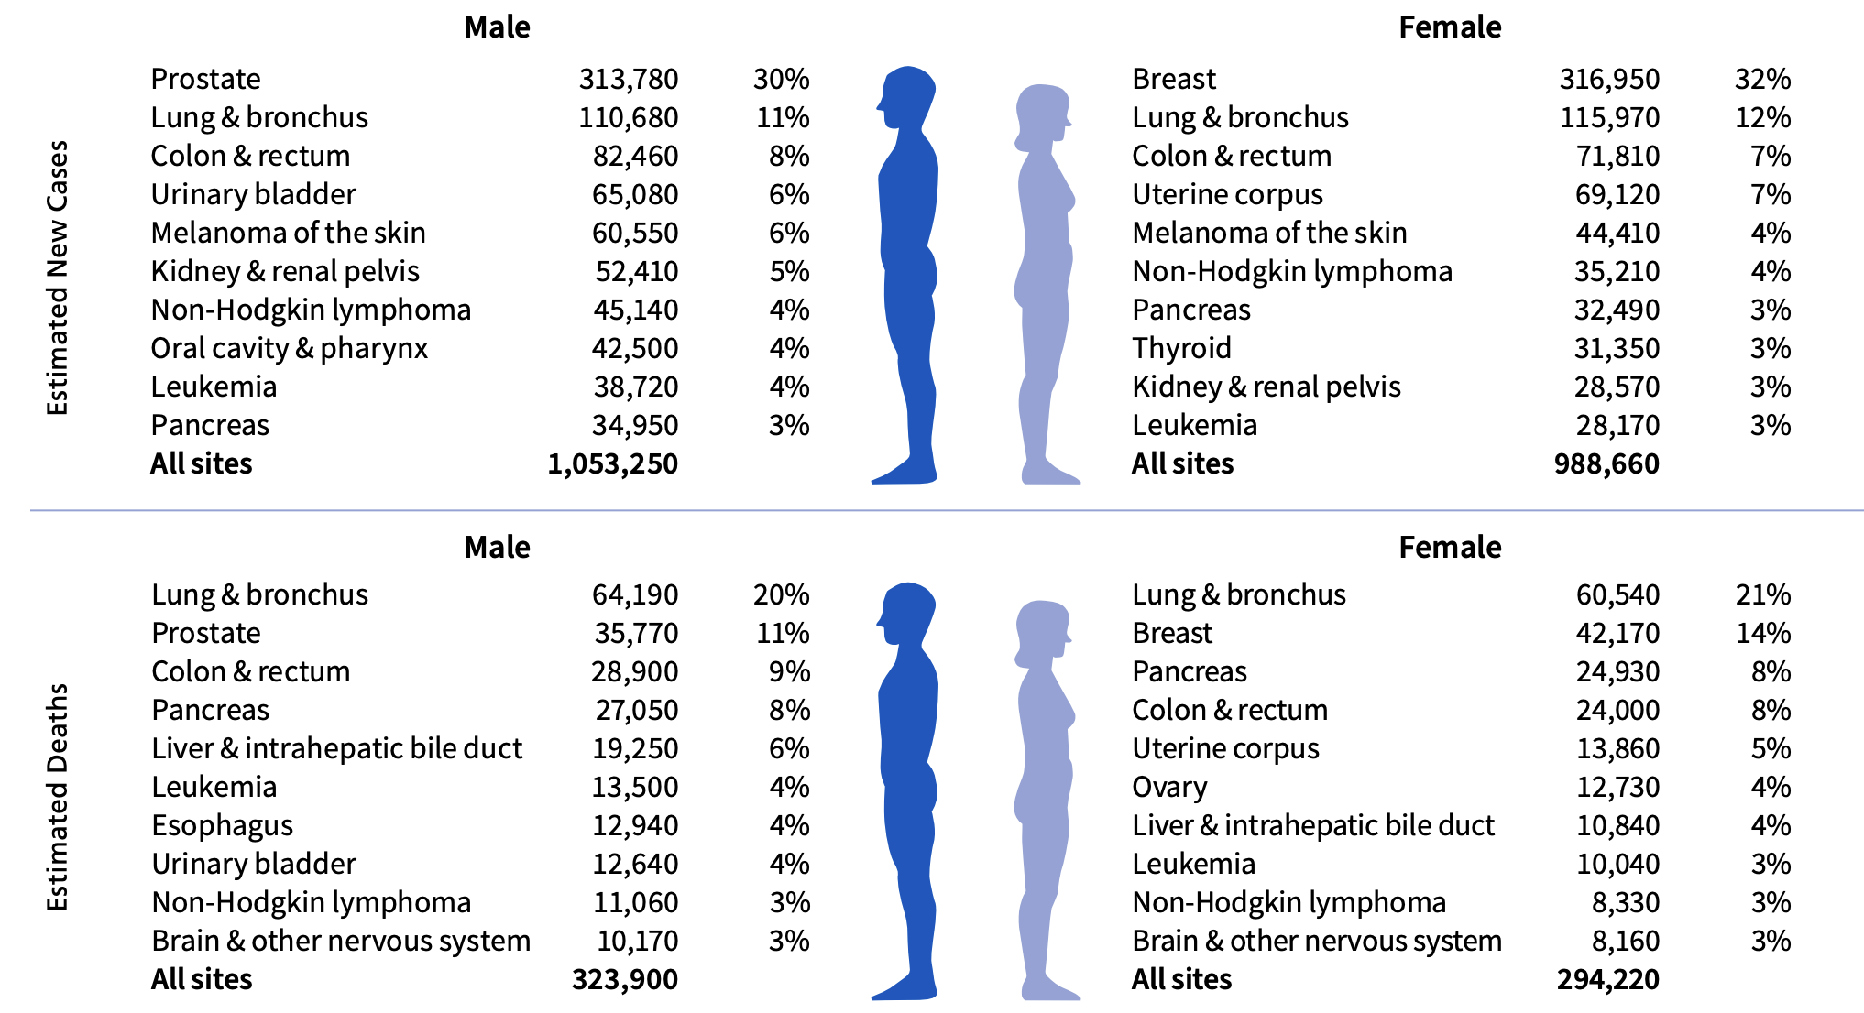
2025 Cancer Incidence and Deaths
Key messages:
Lung cancer deaths are common
(>breast+prostate+colorectal)
Lung cancer cure is usually not cured
Cancer Facts & Figures 2025, American Cancer Society

Slide 5

> 85% of Lung Cancer Is Caused by
Cigarette Smoking

Slide 6
Lung Cancer Deaths
= 124,730 (more than breast + prostate + colon cancer)
Lung Cancer Deaths in Never Smokers
~ 20,000
> Ovarian Cancer
> Kidney Cancer
> Bladder Cancer
~ All Lymphoma
~ All Leukemias

Slide 7
Things I am not going to focus on, but are important
Smoking cessation is critical
The USPSTF recommends annual screening for lung cancer with low-dose computed tomography (LDCT) in adults aged 50 to 80 years who have a 20 pack-year smoking (Grade B recommendation)
Stage I-III lung cancer is curable, typically with a combination of approaches including surgery or radiation along with chemotherapy, immunotherapy and targeted therapy

Slide 8
Metastatic non-small cell lung cancer
2/3 of lung cancer presents with metastatic disease (in part due to lack of implementation of routine CT scan screening)
Associated with dramatically different outcomes based on subtype of non-small cell lung cancer
What we learn in the metastatic context can be used to improve the cure rate for patients with earlier stage disease

Slide 9
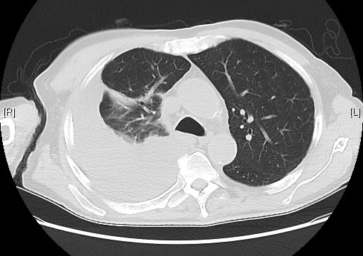
58 year-old former smoker (10 pack years) presents with dyspnea.
Has a large right sided pleural effusion and numerous pulmonary nodules. Thoracentesis yields 500 ml of straw-colored exudate.
Cytology shows adenocarcinoma, TTF-1, Napsin A positive
What other information do you need to develop a treatment plan?
Notes:
POLLING QUESTION
NCCN Clin Info MH 3/28/23: the correct answer is D (see slide 17). this slide can be deleted and used as a pre/post-test question.

Slide 10
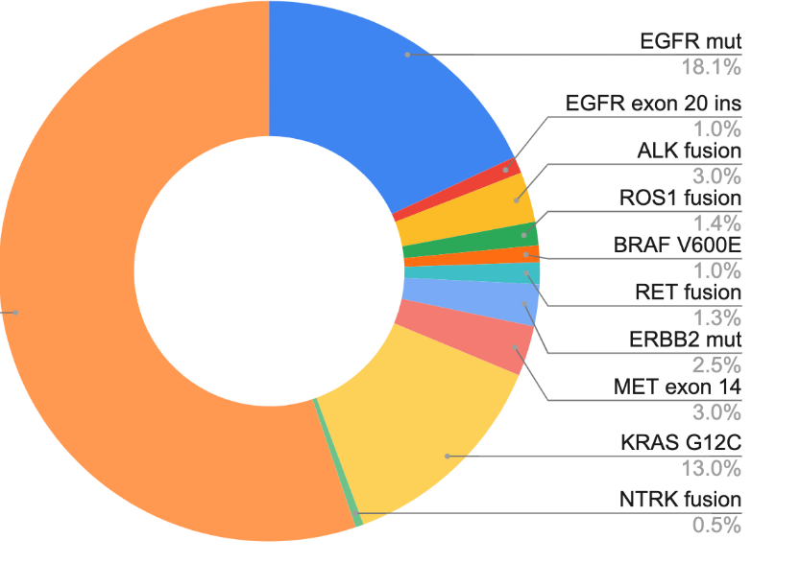
How do we describe NSCLC in 2025?
AACR GENIE BPC lung, Data available at https://genie.cbioportal.org/

Slide 11
A brief history lesson…

Slide 12
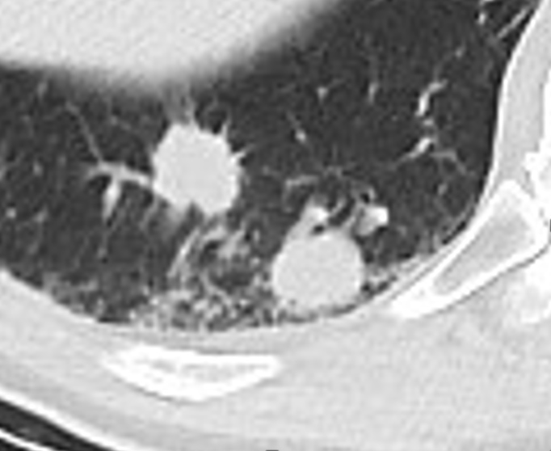
Endpoints used in cancer clinical trials
Response rate – RECIST - ≥ 30% reduction in diameter of indicator tumors (up to 5, max two per organ)
Progression-free survival – time from randomization until tumor grows 20%
Overall survival – time from randomization until death

Slide 13
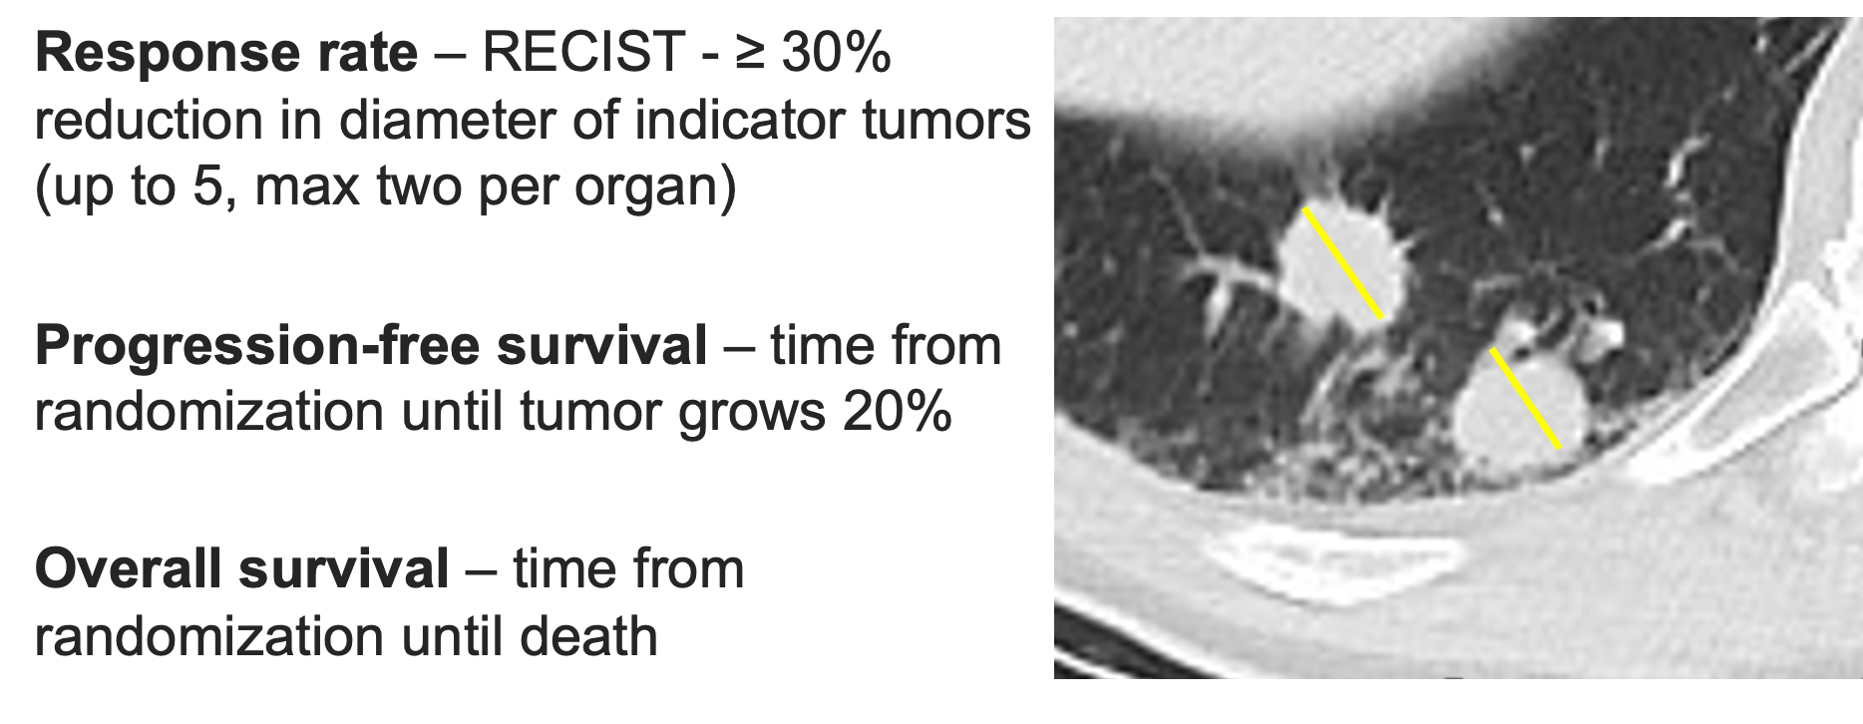
Endpoints used in cancer clinical trials
Surrogate
endpoints

Slide 14
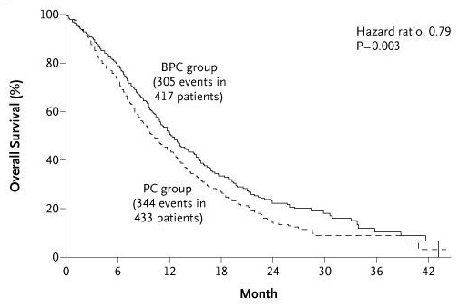
The state of the art initial therapy in 2006…
Addition of a VEGF antibody to chemotherapy improved outcomes a little
Sandler et al, NEJM 2006

Slide 15
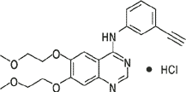
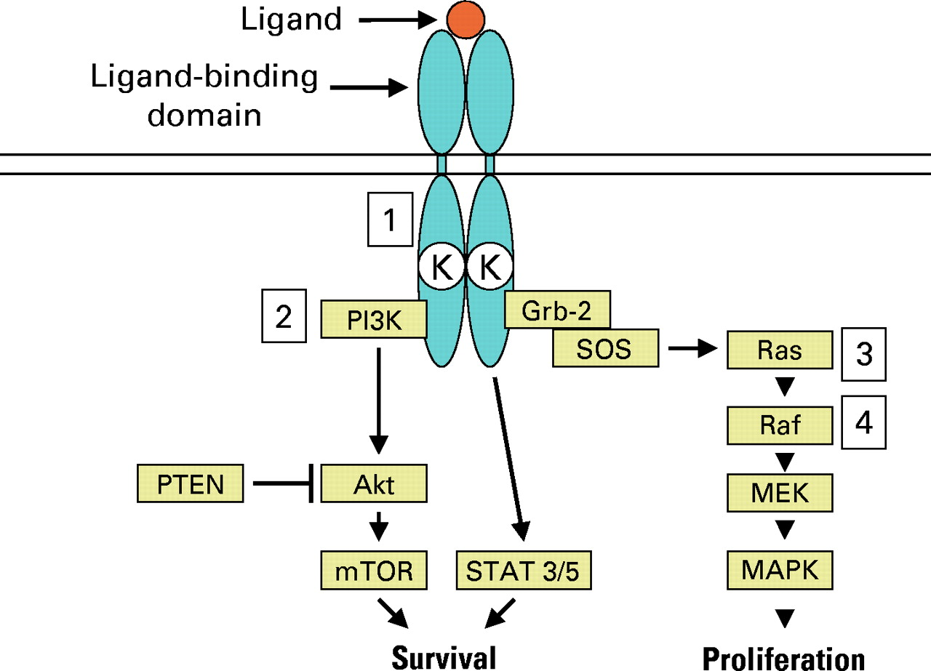
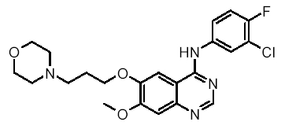
Epidermal Growth Factor Receptor
Signaling
erlotinib
gefitinib
Pao, W. et al. JCO 23:2556-2568 2005

Slide 16
Randomized Trial of Erlotinib
in non-small cell lung cancer
Stage IIIB/IV NSCLC
PS 0–3
1-2 prior therapies
erlotinib + supportive care
placebo + supportive care
Shepherd FA, et al. N Engl J Med. 2005;353:123-132.

Slide 17
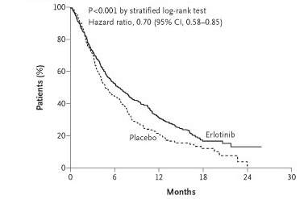
Randomized Trial of Erlotinib in non-small cell lung cancer
Response Rate 9%
Shepherd et al NEJM 353:123-132

Slide 18

Randomized Trial of Erlotinib in non-small cell lung cancer
Response Rate 9%
approved
Shepherd et al NEJM 353:123-132

Slide 19
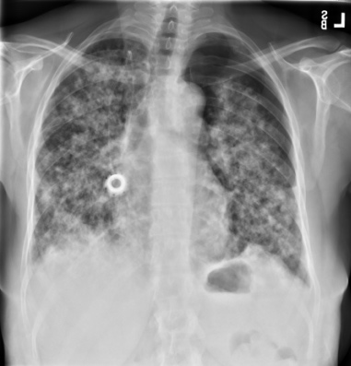
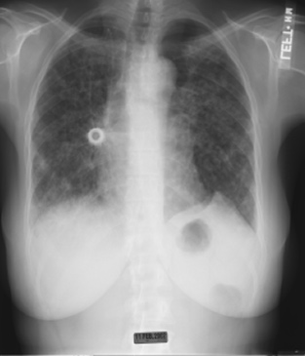
Why Are 1 in 10 Like This?
Day 1
Day 5

Slide 20
Clinical Factors Associated With Response to EGFR TKI
East Asian
Never Smokers
Tumors with adenocarcinoma histology

Slide 21

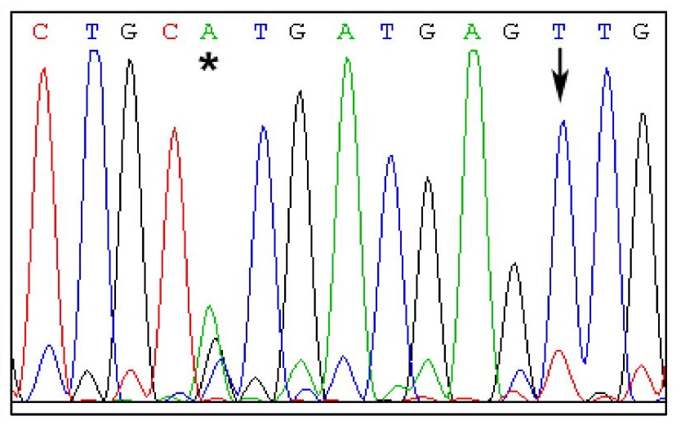
Epidermal Growth Factor Receptor

Slide 22
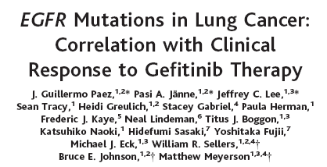
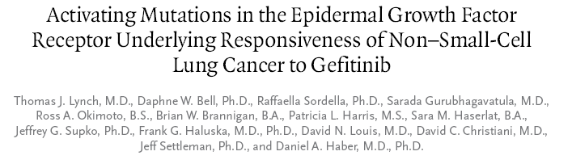
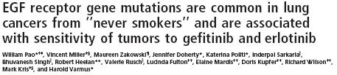
2004
Paez JG, et al. Science. 2004;304(5676):1497-1500.
Lynch TJ, et al. N Engl J Med. 2004;350(21):2129-2139.
Pao W, et al. Proc Natl Acad Sci U S A. 2004;101(36):13306-13311.

Slide 23
EGFR mutations in Non-small cell lung cancer
Exon 19
Deletions
L858R
Clearly associated with response to EGFR TKI
Activating mutations (constitutive activation of EGFR signaling)
Introducing and expressing these mutations in mouse lungs causes lung cancers to develop

Slide 24
EGFR TKI vs Carboplatin - Paclitaxel in Never- or Light Ex-Smokers
Measurable Stage IIIB or IV
Adenocarcinoma histology
No prior chemotherapy
PS 0-2
<100 cigarettes/lifetime or <10 pack- years and stopped ≥15 years prior
R
A
N
D
O
M
I
Z
E
Gefitinib 250 mg/day
Carboplatin AUC 5 or 6
Paclitaxel 200 mg/m²
q3wk (max 6 cycles)

Slide 25
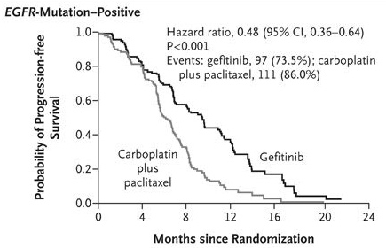
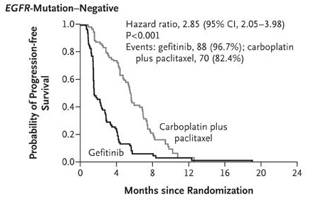
EGFR TKI vs Chemotherapy (Carboplatin-Paclitaxel)
Mok TS, et al. N Engl J Med. 2009;361(10):947-957.
Mok et al NEJM 2009

Slide 26
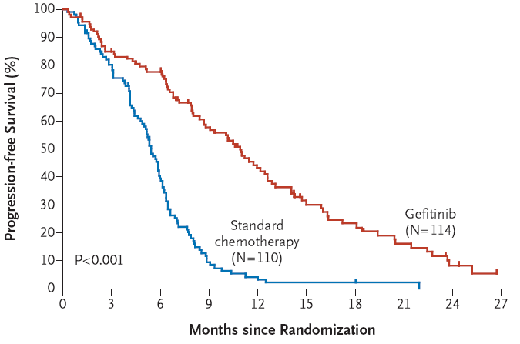
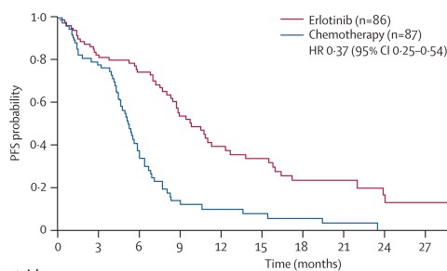
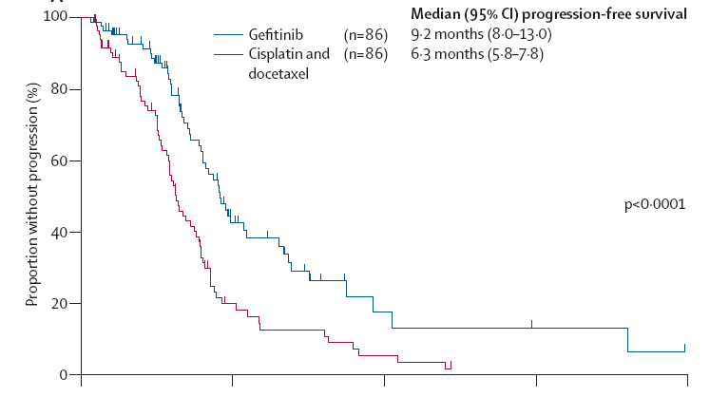
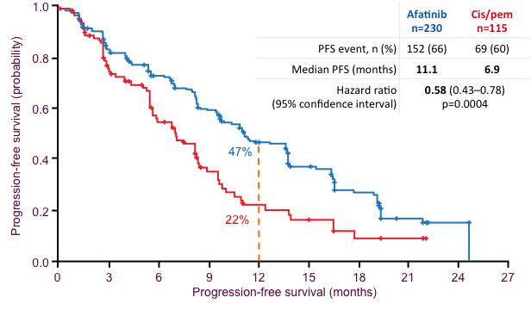
Maemondo et al NEJM 2010, Mitsudomi et al Lancet Oncol 2010, Rosell et al Lancet Oncol 2012, Sequist et al, 2014

Slide 27
EGFR Tyrosine Kinase Inhibitors
(Erlotinib, Gefitinib, or Afatinib)
are better than platinum doublets
in patients with EGFR mutant NSCLC
Maemondo et al NEJM 2010, Mitsudomi et al Lancet Oncol 2010, Rosell et al Lancet Oncol 2012, Sequist et al, 2014

Slide 28
What causes resistance to EGFR TKI?
Diagnosed with EGFR mutant NSCLC
EGFR TKI
Development of Clinical Resistance to EGFR TKI
Biopsy to understand mechanism of resistance

Slide 29
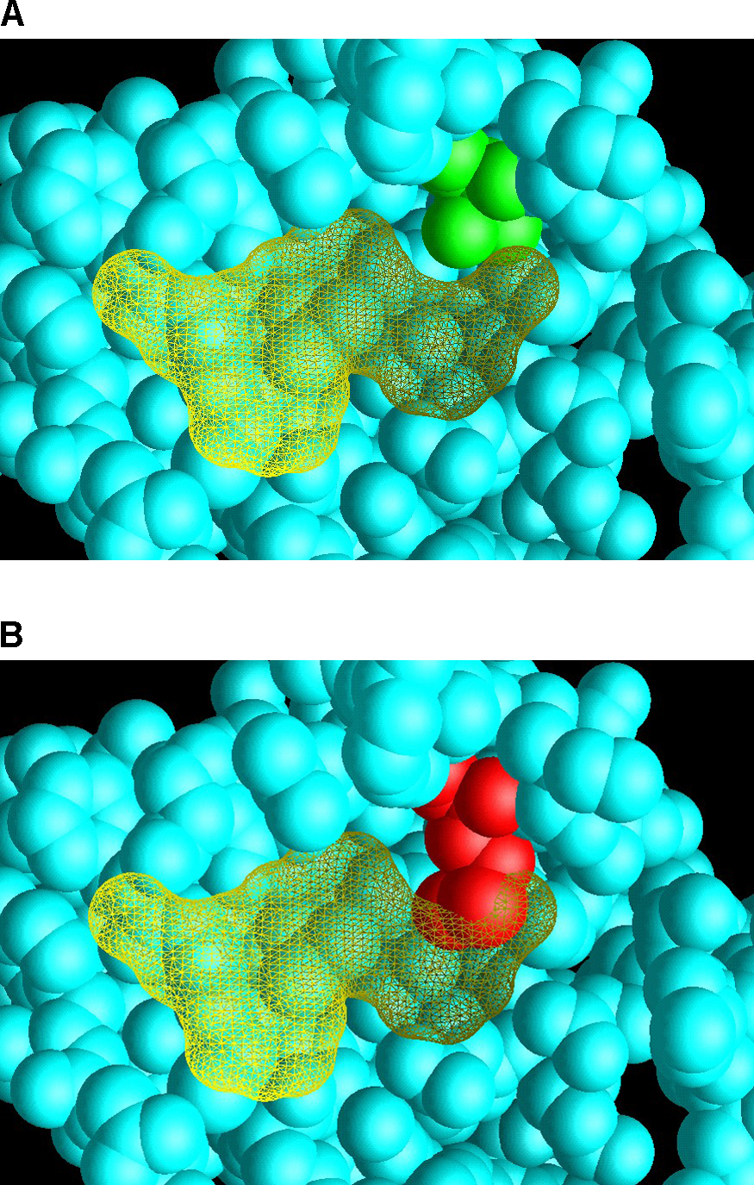
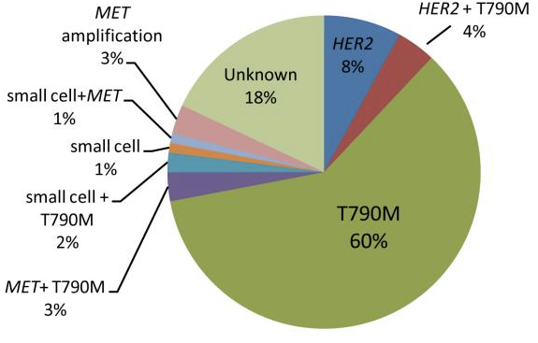
Mechanisms of Acquired Resistance to EGFR Tyrosine Kinase Inhibitors
EGFR T790M is the most common acquired mutation that, in the lab and in patients, causes resistance to EGFR TKI
Clark et al, PLoS Med 2005
Yu et al, CCR 2013

Slide 30
Spectrum of Activity of EGFR TKIs
 | Drug | EGFR
1st gen | gefitinib | +
 | erlotinib | +
2nd gen | afatinib | +

Slide 31
Spectrum of Activity of EGFR TKIs
 | Drug | EGFR | EGFR L858R | EGFR Exon 19 del
1st gen | gefitinib | + | + | +
 | erlotinib | + | + | +
2nd gen | afatinib | + | + | +

Slide 32
Spectrum of Activity of EGFR TKIs
 | Drug | EGFR | EGFR L858R | EGFR Exon 19 del | EGFR T790M*
1st gen | gefitinib | + | + | + | -
 | erlotinib | + | + | + | -
2nd gen | afatinib | + | + | + | -
*Common resistance mechanism to 1st and 2nd generation EGFR TKI

Slide 33
Spectrum of Activity of EGFR TKIs
 | Drug | EGFR | EGFR L858R | EGFR Exon 19 del | EGFR T790M*
1st gen | gefitinib | + | + | + | -
 | erlotinib | + | + | + | -
2nd gen | afatinib | + | + | + | -
3rd gen | osimertinib | - | + | + | +
*Common resistance mechanism to 1st and 2nd generation EGFR TKI

Slide 34
Osimertinib vs Gefitinib or Erlotinib Randomized Trial
Osimertinib
(n=279)
Metastatic NSCLC
EGFR mutation
No prior therapy
Stable CNS metastases allowed
Performance status 0 / 1
Gefitinib or Erlotinib
(n=277)
Primary endpoint: PFS
Secondary endpoints: response rate, duration of response, disease control rate, depth of response, overall survival, patient reported outcomes, safety
Soria et al, NEJM 2017

Slide 35
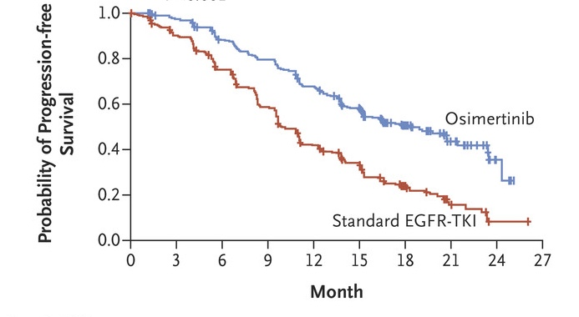
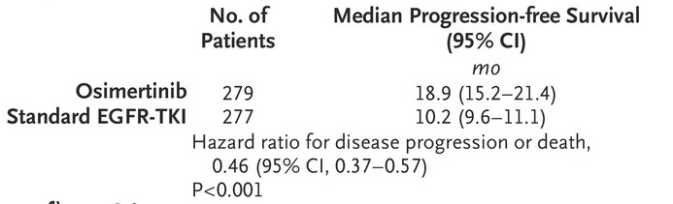
Osimertinib vs Gefitinib or Erlotinib as first-line treatment for NSCLC - Progression-Free Survival
Soria et al, NEJM 2017

Slide 36
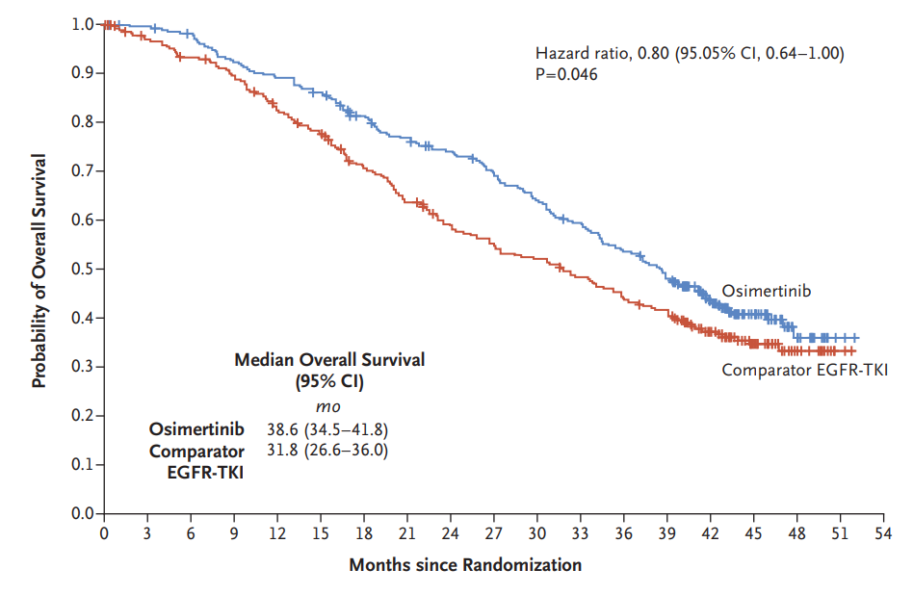
Osimertinib vs Gefitinib or Erlotinib as first-line treatment for NSCLC - Overall Survival
Ramalingam et al, NEJM 2020

Slide 37

Osimertinib vs Gefitinib or Erlotinib as first-line treatment for NSCLC - Overall Survival
Ramalingam et al, NEJM 2020

Slide 38
The triumph of precision medicine in solid tumors…
There was a molecularly-defined drug target
Patients were treated with a first-generation targeted therapy which had modest efficacy (erlotinib, gefitinib, afatinib)

Slide 39
The triumph of precision medicine in solid tumors…
There was a molecularly-defined drug target
Patients were treated with a first-generation targeted therapy which had modest efficacy (erlotinib, gefitinib, afatinib)
Translational work identified how patients develop acquired resistant (dominant mechanisms was emergence of T790M)

Slide 40
The triumph of precision medicine in solid tumors…
There was a molecularly-defined drug target
Patients were treated with a first-generation targeted therapy which had modest efficacy (erlotinib, gefitinib, afatinib)
Translational work identified how patients develop acquired resistant (dominant mechanisms was emergence of T790M)
A drug was developed to target the mechanism of resistance (3rd generation EGFR TKI like osimertinib) and it improved initial therapy outcomes

Slide 41
The triumph of precision medicine in solid tumors…
There was a molecularly-defined drug target
Patients were treated with a first-generation targeted therapy which had modest efficacy (erlotinib, gefitinib, afatinib)
Translational work identified how patients develop acquired resistant (dominant mechanisms was emergence of T790M)
A drug was developed to target the mechanism of resistance (3rd generation EGFR TKI like osimertinib) and it improved initial therapy outcomes
Target
Resistance
Now, all we need to do is iterate, right?

Slide 42
Osimertinib vs Gefitinib/Erlotinib as first treatment for NSCLC Progression-Free Survival
Soria et al, NEJM 2017

Slide 43
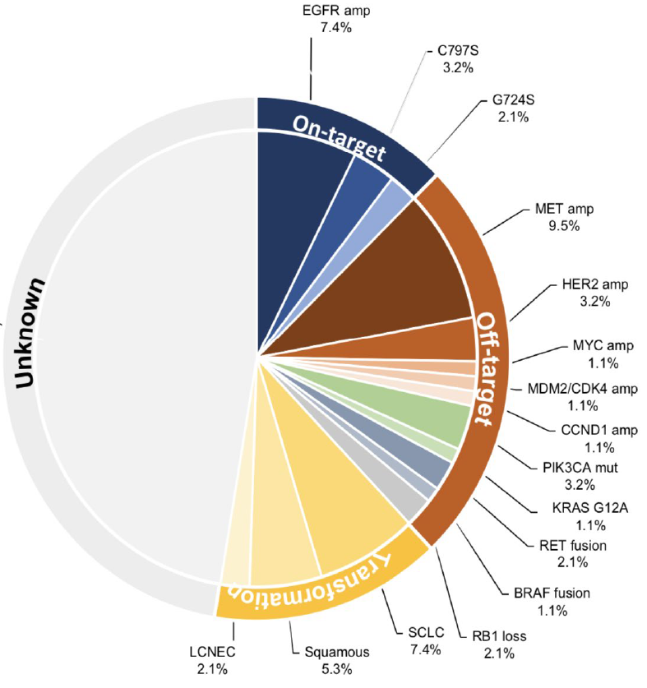
Mechanisms of acquired resistance to first-line Osimertinib are much more complicated!
Choudhury et al, J Thor Onc, 2023

Slide 44
Mechanisms of acquired resistance to first-line Osimertinib are much more complicated!
Choudhury et al, J Thor Onc, 2023

Slide 45
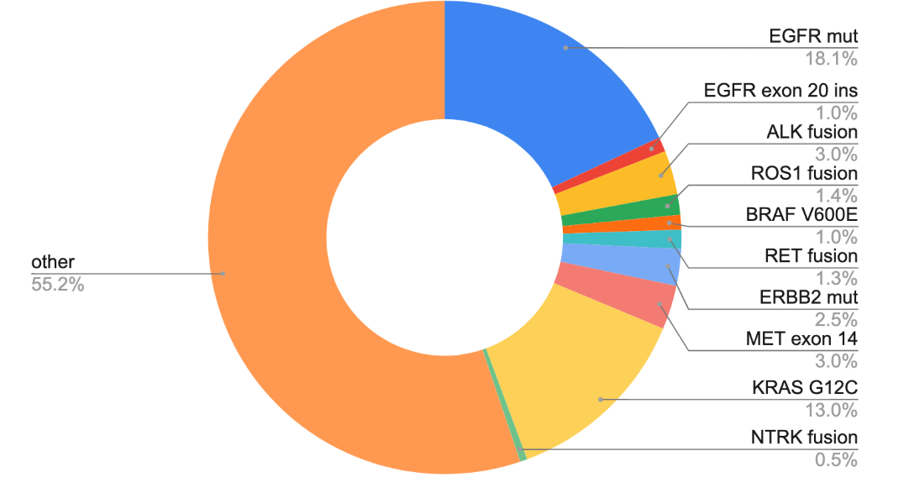
Lung cancer molecular subtypes with FDA-approved agents
FDA-approved 1st line therapies
Erlotinib, gefitinib, afatinib, dacomitinib, osimertinib, amivantamab, lazertinib
amivantamab
Crizotinib, alectinib, brigatinib, ceritinib, lorlatinib, ensartinib
Crizotinib, entrectinib, repotrectinib
Encorafenib/binimetinib, dabrafenib/trametinib
Pralsetinib, selpercatinib
Tepotinib, capmatinib
Entrectinib, Larotrectinib
AACR GENIE BPC lung, Data available at https://genie.cbioportal.org/

Slide 46
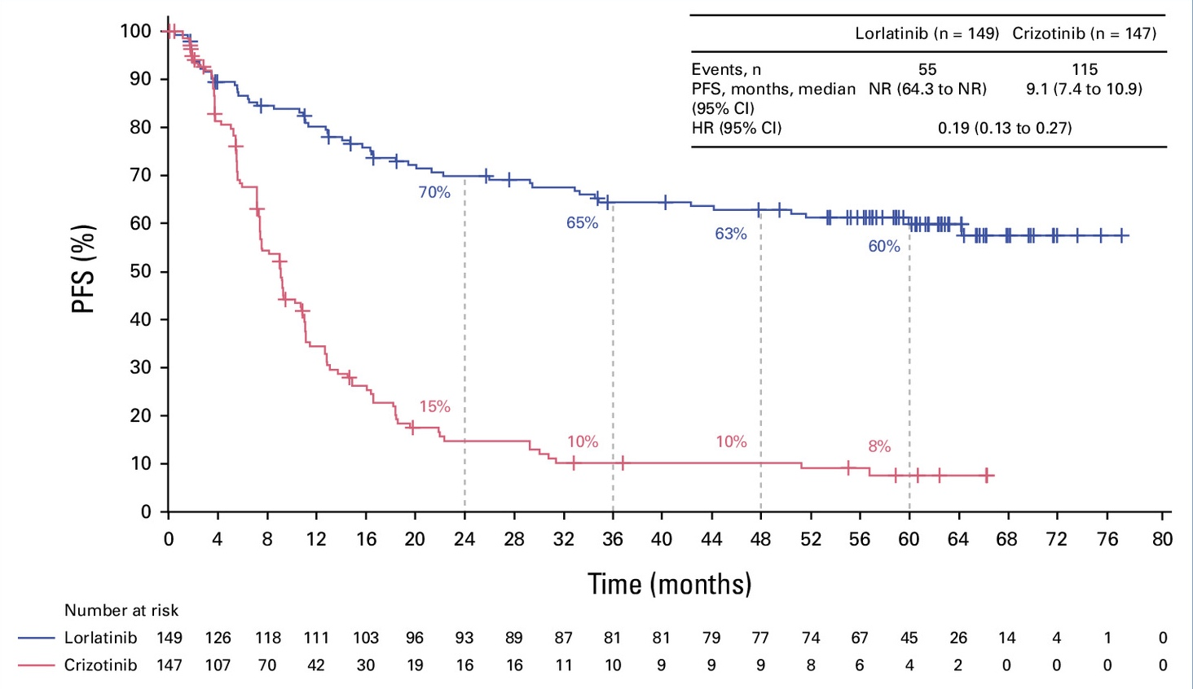
Targeted therapy can lead to long-term responses lorlatinib in ALK positive lung cancer
Solomon et al, JCO 2024

Slide 47
So, today, when we meet a new patient with non-small cell lung cancer…
Initial biomarker characterization is key. How do we do it?
Adequate testing covers all 9 of the genes noted
Typical commercial platform covers hundreds of genes and we get results in <2 weeks
If adequate tissue wasn’t collected we can sometimes get this information by looking for shed tumor DNA in plasma (ctDNA, “liquid biopsy”)
In addition to molecular testing, we also test for other markers (e.g. PD-L1 levels) to determine the role of immunotherapy/chemotherapy

Slide 48
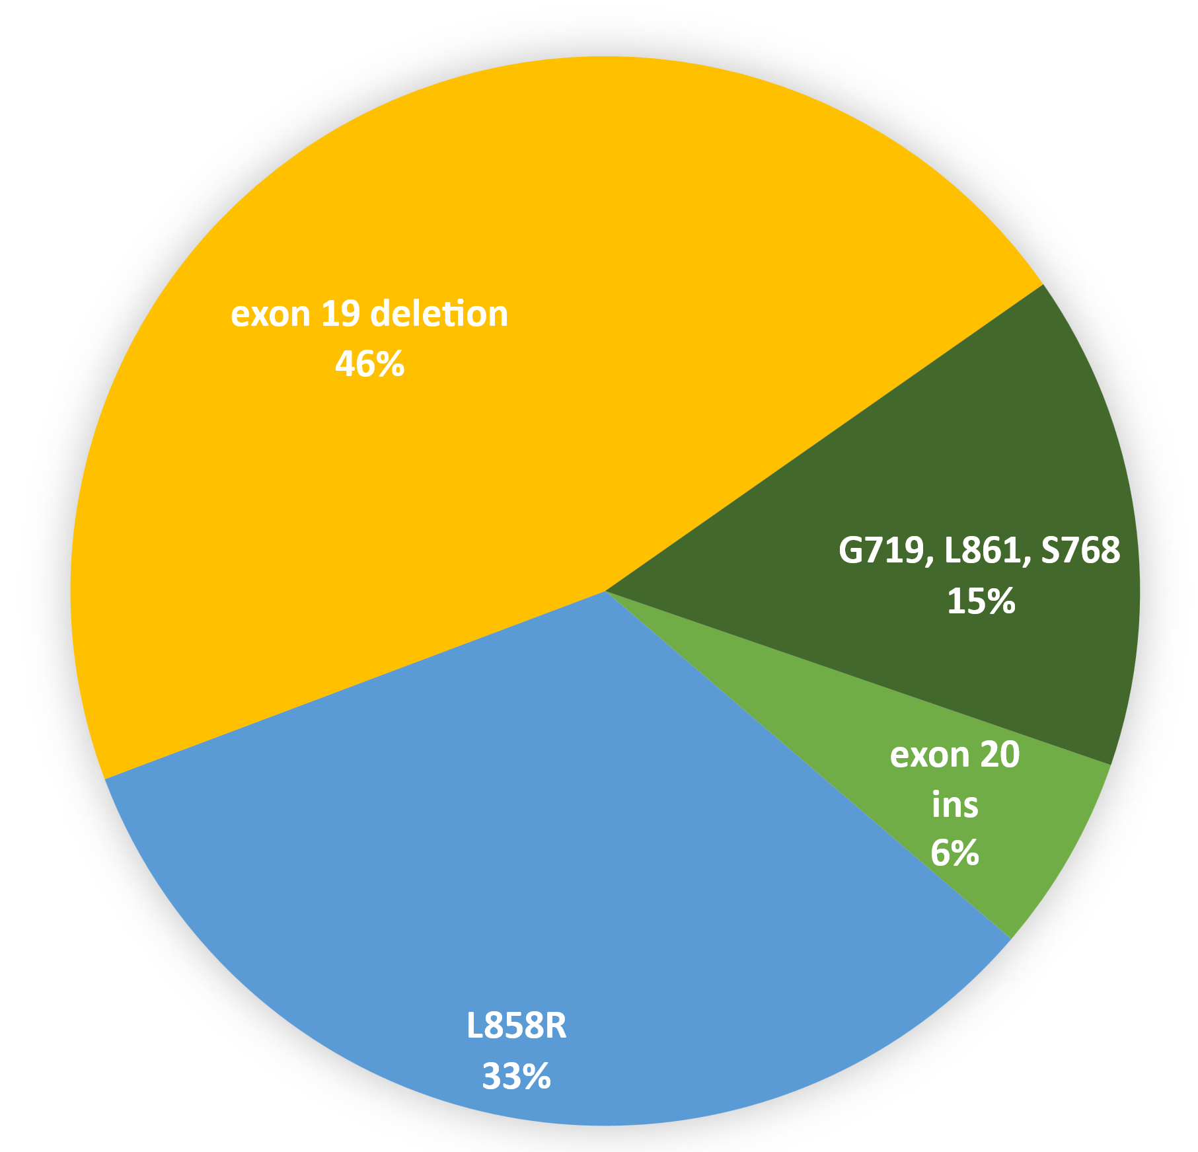
But, EGFR mut NSCLC is more complicated…
79% of patient have classically sensitizing EGFR mutations (exon 19 deletion and L858R)
15% of patient have “atypical” EGFR mutations
6% of patient have EGFR exon 20 insertions
From AACR GENIE v 11 public

Slide 49
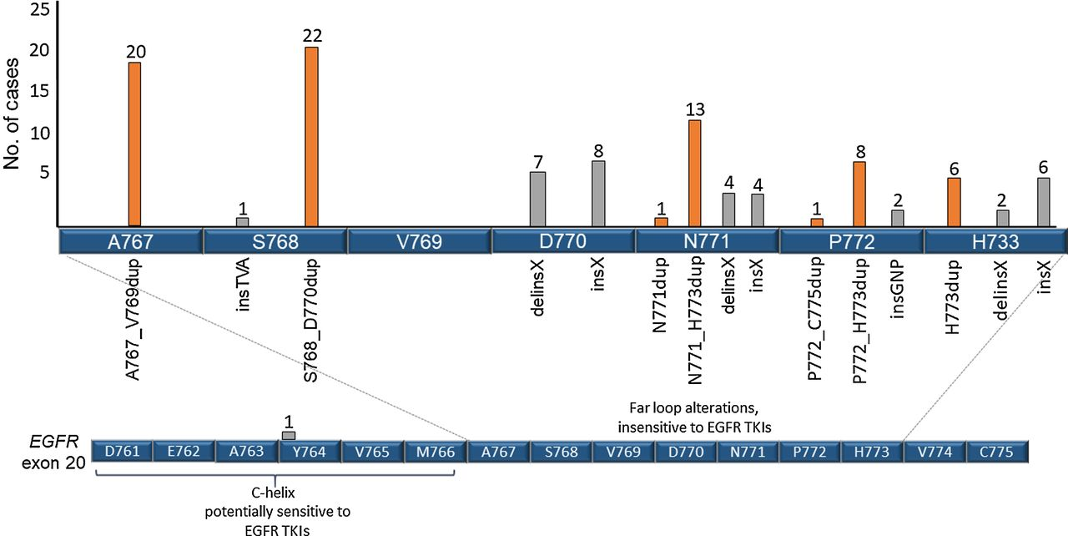
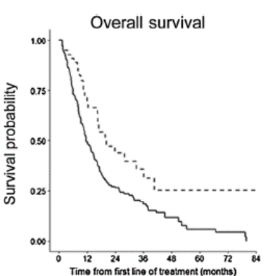
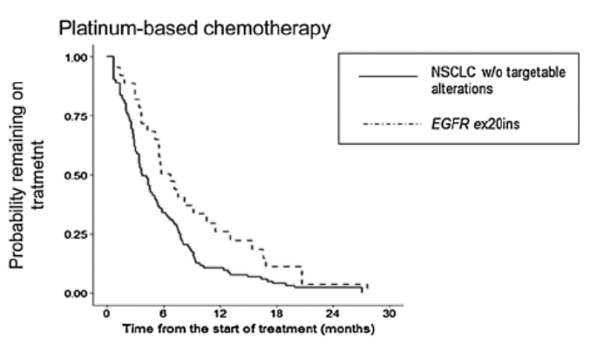
EGFR exon 20 insertions in lung cancer
~1% of people with NSCLC
More common in adenocarcinoma
More common in Asian Americans
More common in African Americans
Associated with better prognosis compared to patients without targetable oncogenes
Choudhury et al, CCR 2021

Slide 50
1st generation EGFR TKI are generally not active in patients with EGFR exon 20 insertions
rwPFS
3.1 mo
3.3 mo
4.5 mo
5.7 mo
Ou et al ASCO 2021

Slide 51
Trying to target EGFR exon 20 ins NSLC
Tyrosine kinase inhibitor
oral
Gonzalvez et al, Can Discovery 2021

Slide 52
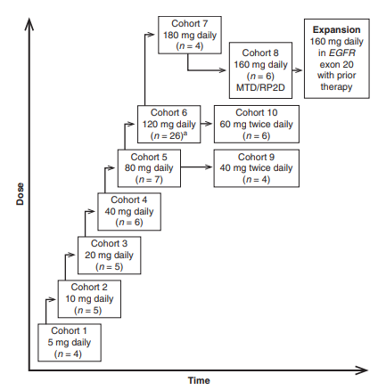
Dose escalation of mobocertinib
No DLTs, no responses
Riely et al, Cancer Discovery 2021

Slide 53
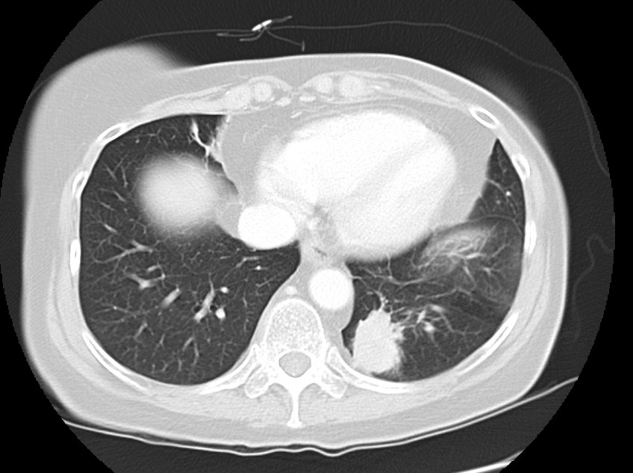
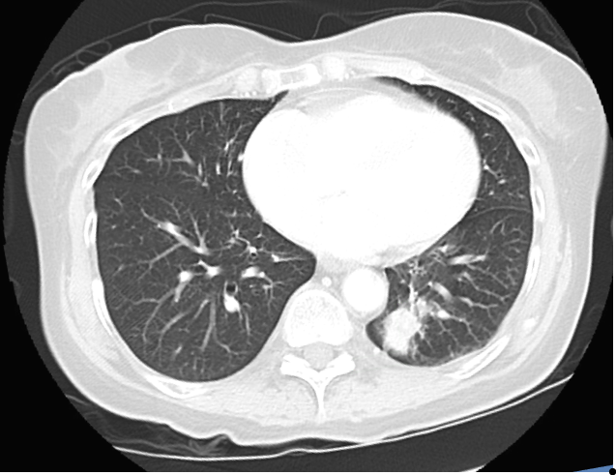
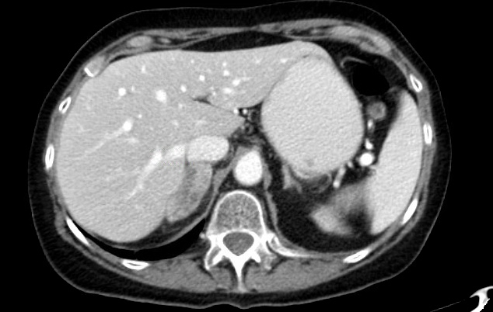
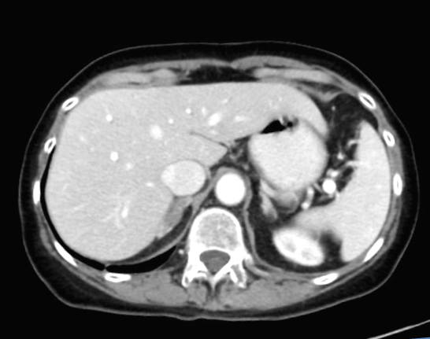
Dose escalation of mobocertinib
No DLTs, no responses
Day -7
Day 55
Patient treated with 80 mg June 2017
Riely et al, Cancer Discovery 2021

Slide 54
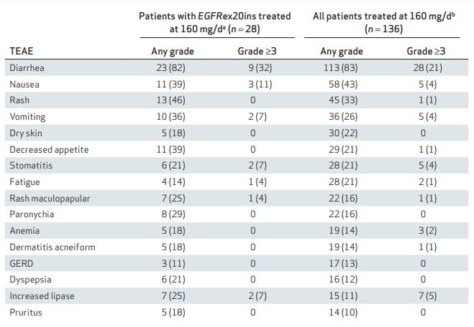
Mobocertinib: Treatment-related Adverse Events
Riely et al, Cancer Discovery 2021

Slide 55
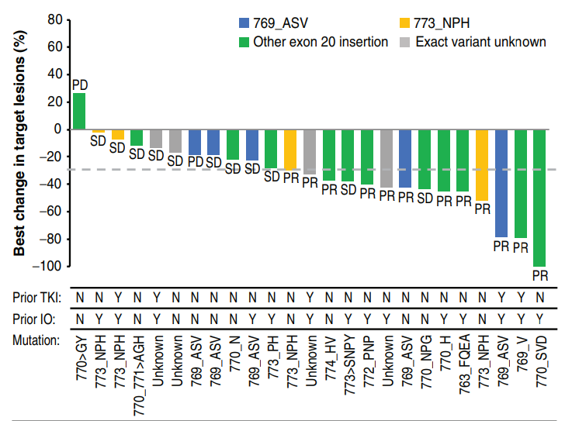
Mobocertinib efficacy
Response Rate
43%
Riely et al, Cancer Discovery 2021

Slide 56
Further evaluation of mobocertinib
Recurrent/Metastatic NSCLC
EGFR Exon 20 insertion
Prior systemic therapy
n = ~100
Primary endpoint
RR by BICR
mobocertinib

Slide 57
Response to Mobocertinib in Patients With EGFR Exon 20 Insertions Treated at 160 mg qd
Response Rate
28%
Zhou et al, JAMA Onc 2021

Slide 58
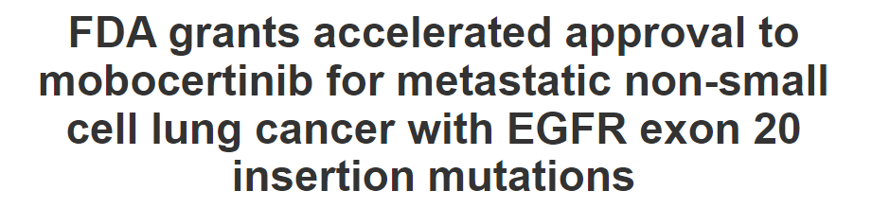
09/16/2021

Slide 59
This indication is approved under accelerated approval based on overall response rate and duration of response. Continued approval for this indication may be contingent upon verification and description of clinical benefit in a confirmatory trial(s).

Slide 60
Idea 1: Trial of Mobocertinib in 2nd/3rd line
mobocertinib
Recurrent/Metastatic NSCLC
EGFR Exon 20 insertion
Prior systemic therapy
Primary endpoint
PFS
R
docetaxel

Slide 61
Idea 1: Trial of Mobocertinib in 2nd/3rd line
mobocertinib
Recurrent/Metastatic NSCLC
EGFR Exon 20 insertion
Prior systemic therapy
Primary endpoint
PFS
R
docetaxel
RR: 9-12%
mPFS: 3-4 mo

Slide 62
Idea 2: Trial of Mobocertinib in 1st line
mobocertinib
Recurrent/Metastatic NSCLC
EGFR Exon 20 insertion
No prior systemic therapy
N=318
Primary endpoint
PFS by BICR using RECIST v1.1
R
carboplatin or cisplatin
+
pemetrexed
ClinicalTrials.gov Identifier: NCT04129502

Slide 63
Idea 2: Trial of Mobocertinib in 1st line
mobocertinib
Recurrent/Metastatic NSCLC
EGFR Exon 20 insertion
No prior systemic therapy
N=318
Primary endpoint
PFS by BICR using RECIST v1.1
R
carboplatin or cisplatin
+
pemetrexed
RR: 19-30%
mPFS: 6-7 mo
ClinicalTrials.gov Identifier: NCT04129502

Slide 64
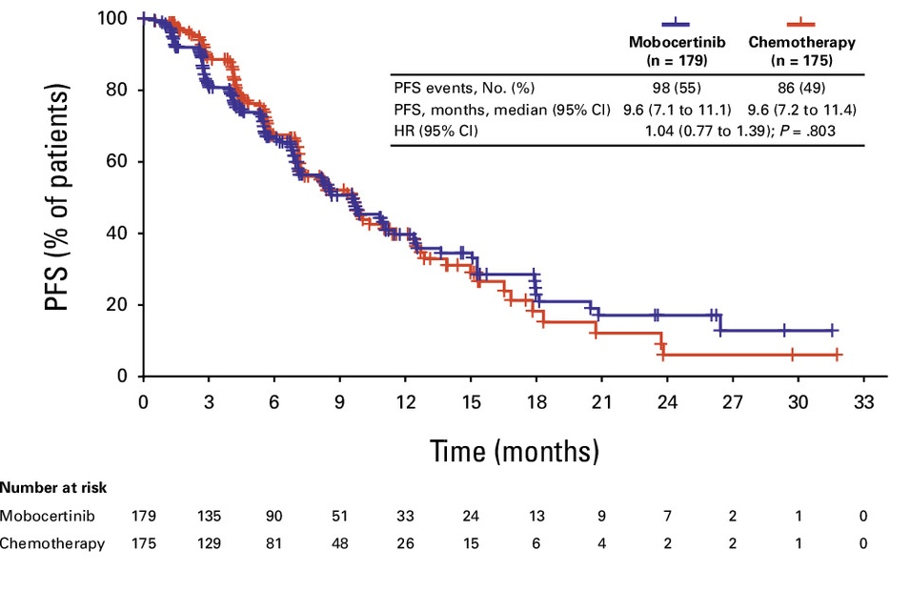
Mobocertinib vs Chemotherapy Progression-Free Survival similar between arms
Janne et al, JCO 2025

Slide 65
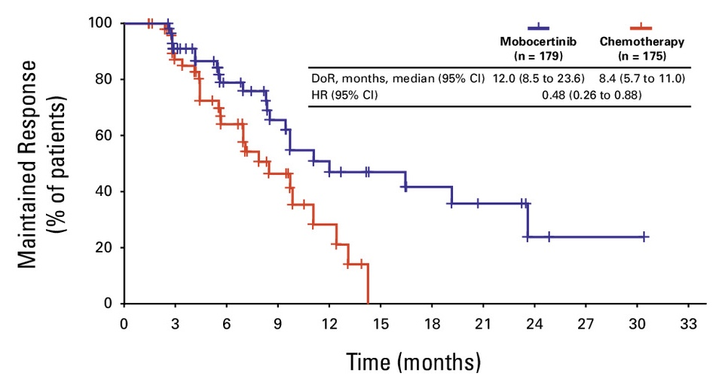
Mobocertinib vs Chemotherapy Duration of response in confirmed responders
Janne et al, JCO 2025

Slide 66
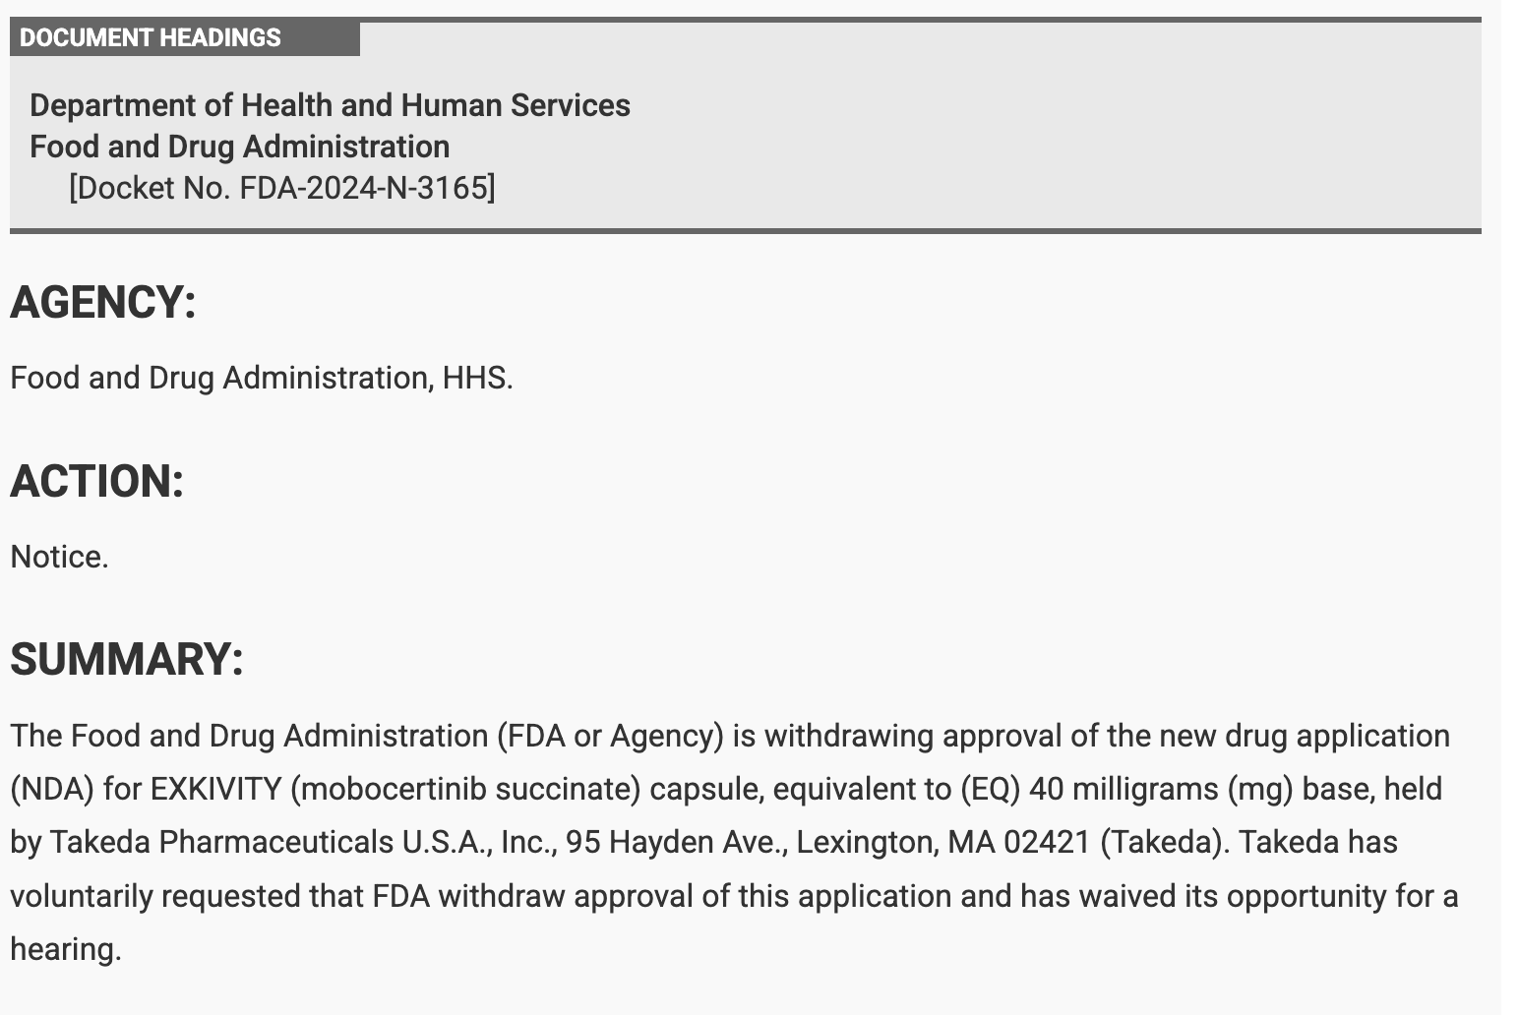
Withdrawal of mobocertinib from the market
Federal Register

Slide 67
What about some of the more challenging targets?
Mutations/Gene Fusions (by NGS)
KRAS…more than a quarter of NSCLC!
Notes:
NCCN Clin Info MH 3/28/23: Title: Is this is metastatic NSCLC? Is it adenocarcinoma?

Slide 68
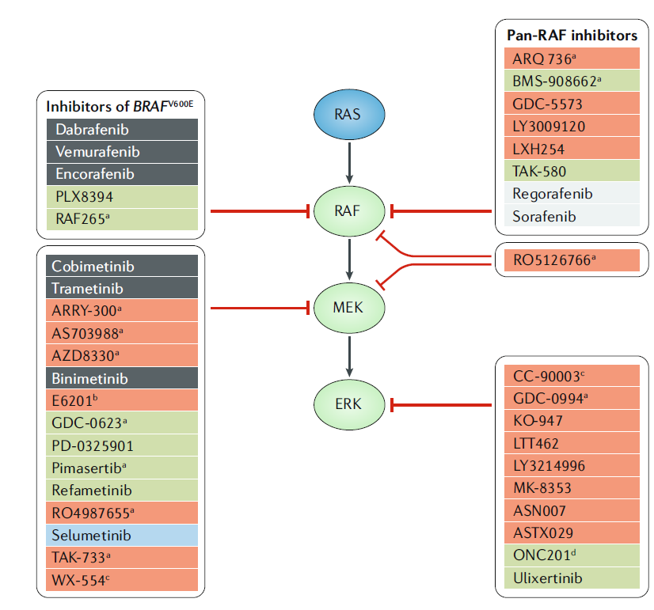
How do we target KRAS mutant cancers?
Prior to development of direct KRAS inhibitors, the focus was on inhibition of downstream signaling molecules.
Ryan and Corcoran, Nat Reviews Clinical Oncology 2018

Slide 69
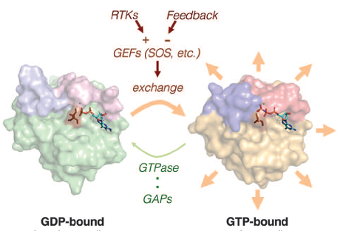
Mutations in RAS lack GTPase activity, leaving mutant KRAS constitutively active
Fixing an enzyme that is broken is hard
Modified from Lito et al, Science 2016

Slide 70
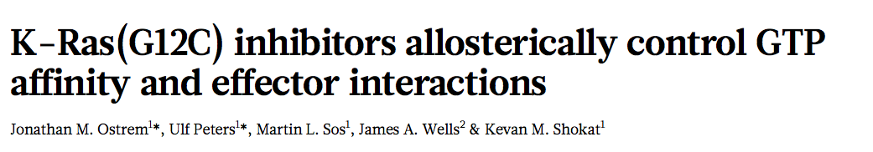
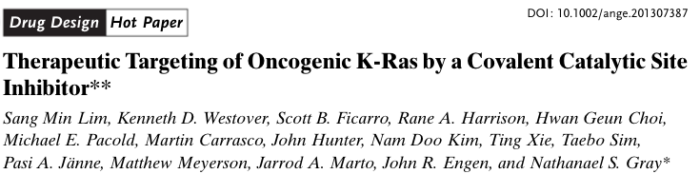
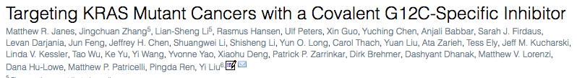
The New Hope – Direct RAS inhibitors
Nature 2013
Angewandte Chemie International Edition 2013
Cell 2018

Slide 71
Mutations in RAS lack GTPase activity, leaving mutant KRAS constitutively active
Fixing an enzyme that is broken is hard
Modified from Lito et al, Science 2016

Slide 72

It turns out that mutant KRAS does have low level GTPase activity
Lito et al, Science 2016

Slide 73

KRAS G12C inhibitors bind inactive, GDP-bound RAS G12C and trap it in an inactive state
Lito et al, Science 2016

Slide 74




Skoulidis F, Li B et al, NEJM 2021

Slide 75




Jänne PA, Riely GJ et al. NEJM 2022;387(2):120-31.

Slide 76


Randomized Trials targeting KRAS G12C
KRAS targeted therapy
KRAS mutant NSCLC
Previously treated with chemo/IO
docetaxel
Sotorasib
Adagrasib
Langen et al Lancet 2023
Mok et al ASCO 2024

Slide 77


Resistance to KRAS G12C inhibitors develops from multiple mechanisms
Zhao et al, Nature 2021

Slide 78
Conclusions
Developing targeted therapies can make significant improvements in outcomes for patients with NSCLC
Testing for genomic alterations is critical to knowing
This requires adequate tissue to be obtained at time of diagnosis
Identifying mechanisms of resistance is important and can sometimes lead to the next therapy
True progress requires translational science and randomized clinical trials

Slide 79
Acknowledgements
Thoracic Oncology Service
Mark Kris
Charlie Rudin
Paul Paik
Jamie Chaft
Noura Choudhury
Marjorie Zauderer
Helena Yu
Alex Drilon
Kathryn C. Arbour
Robert Daly
Adam Schoenfeld
Mark Awad
Pathology
Marc Ladanyi
Maria Arcila
William Travis
Natasha Rehktman
Andre Moreira
Sloan Kettering Institute
Neal Rosen
Piro Lito
Scott Lowe
Dana Farber Cancer Institute
Päsi Janne
Cloud Paweletz
Funding Sources
Stand Up 2 Cancer
National Cancer Institute
Mark Foundation
Ning Zhao and Ge Li Initiative for Lung Cancer Research
Dallepezze Family Foundation
Mirati
Takeda
AACR

